Slide 1
ML CAPSTON PROJECT
‘CAR PRICE PREDICTION’
BY
SWAPNIL POWAR

Slide 2
PROBLEM STATEMENT:
THE DATASET WAS ASSEMBLED IN DECEMBER 2021. THE DATA IS FROM WELL KNOWN CAR SALE SITE IN POLAND.
THE DATASET CONTAINS THE INFORMATION ABOUT THE MAKE, MODEL, GENERATION,YEAR OF PRODUCTION, MILEAGE, ENGINE TYPE, VOLUME, LOCALISATION AND TARGET VARIABLE PRICE.
FOLLOWING ARE THE COLUMNS DESCRIPTION:
MARK : GIVES AN IDEA ABOUT THE COMPANY i.e. BMW, AUDI, MERCEDES-BENZ.
MODEL : SPECIFIES THE TYPE OF MODEL OF A CAR.
GENERATION NAME : IT GIVES GENERATION OF CAR.
YEAR : YEAR OF MANUFACTURING OF CAR.
MILEAGE : IT GIVES THE MILEAGE OF A CAR. i.e. EFFICIENCY OF THE CAR.
VOL_ENGINE : VOLUME OF ENGINE IN mm3.
FUEL : ADVISABLE FUEL FOR A CAR. i.e. DIESEL, CNG, GASOLINE , LPG.
CITY : CITY FROM WHERE THE CAR BELONGS FROM.
PROVINCE : PROVINCE FROM WHERE THE CAR BELONGS FROM.
PRICE : FINAL PRICE OF THE CAR.
USE PROPER ML TECHNIQUES FOR PREDICTING THE UPCOMING CAR PRICES WITH THIS INFORMTION.

Slide 3
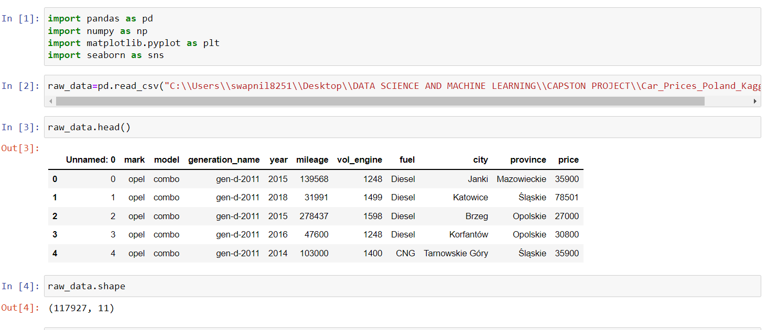
METHODOLOGY:
1. IMPORTING VARIOUS LIBRARIES AND READING THE DATA.

Slide 4
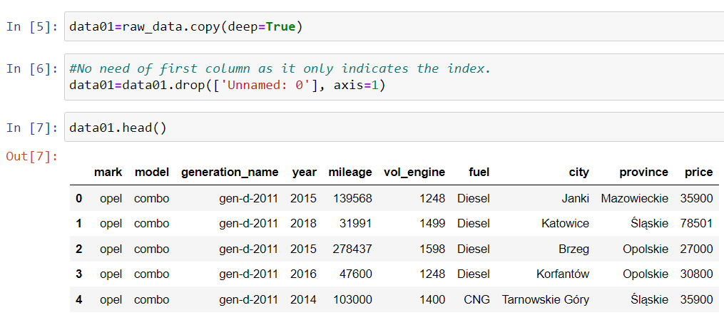
2. DELEATING THE COLUMN ‘UNNAMED:0’ AS IT ONLY CONTAINS INDEX NUMBER ONLY.

Slide 5
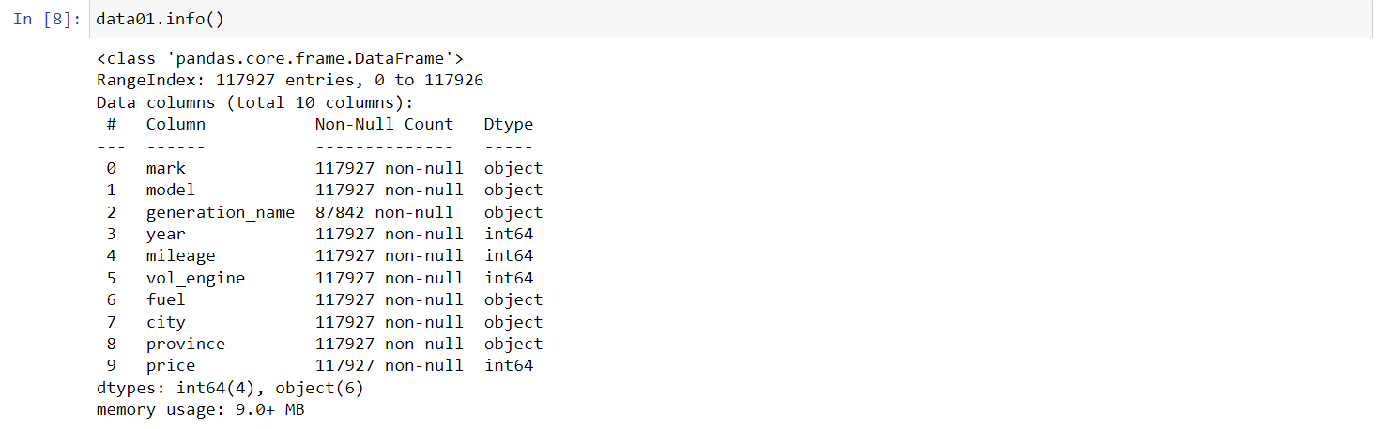
THIS TABLE SHOWS THAT ONLY COLUMN ‘GENERATION NAME’ HAS NON-NULL VALUES.
3. COLLECTING THE DATA INFORMATION WITH SINGLE STEP.

Slide 6
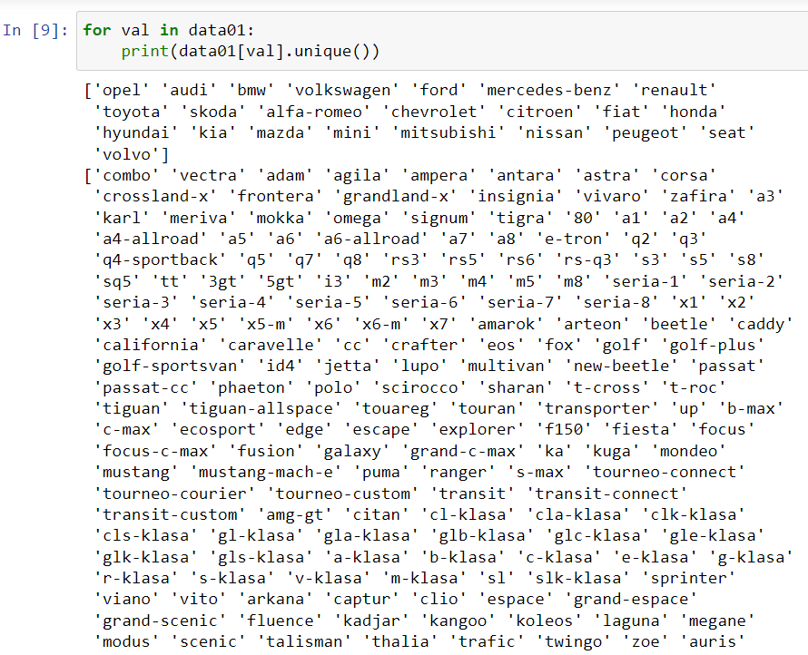
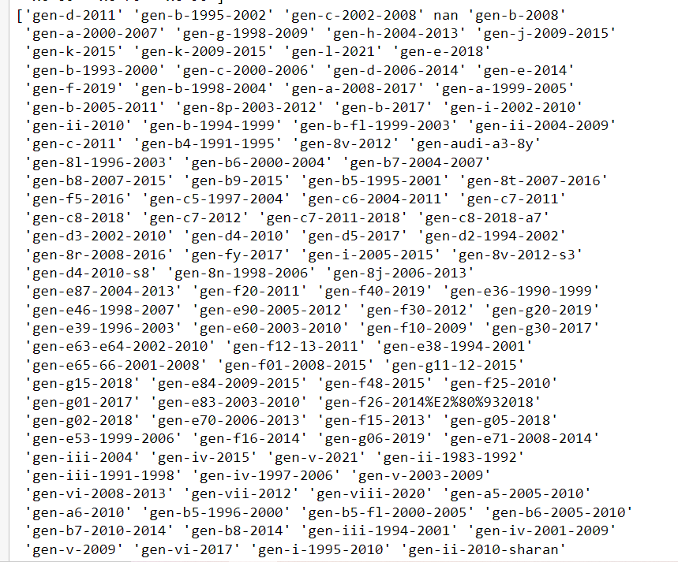
LOTS OF UNIQUE VALUES FOUND IN THE CALUMNS, BUT ONLY FUEL COLUMN HAS 7 UNIQUE VALUES.
4. CHECKING FOR THE UNIQUE VALUES IN CATEGORICAL VALUES.

Slide 7
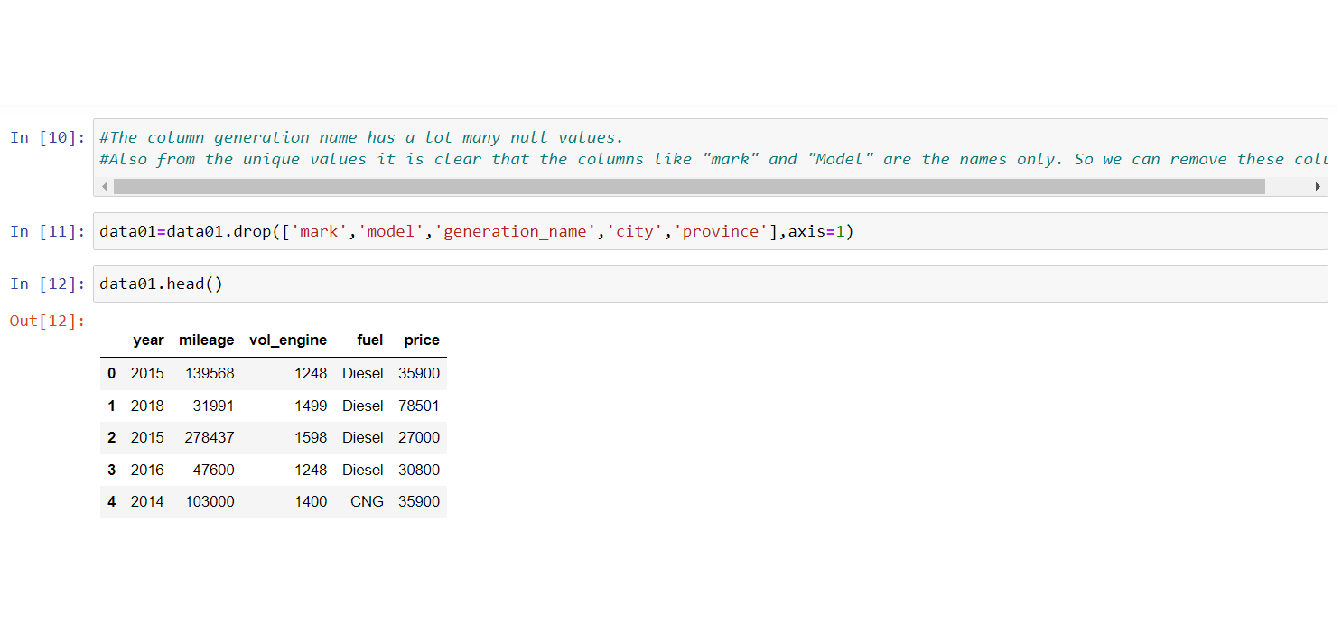
5. DROPPING THE UNNECESSARY COLUMNS AS IT CONTAINS NAMES AND CITY(AREA) DESCRIPTION.

Slide 8
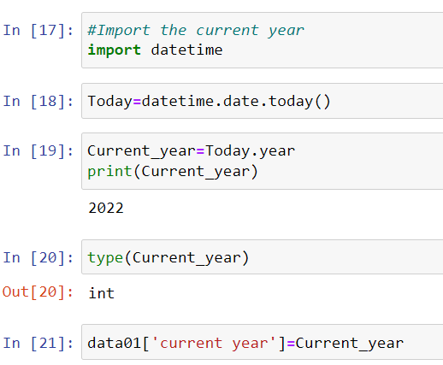
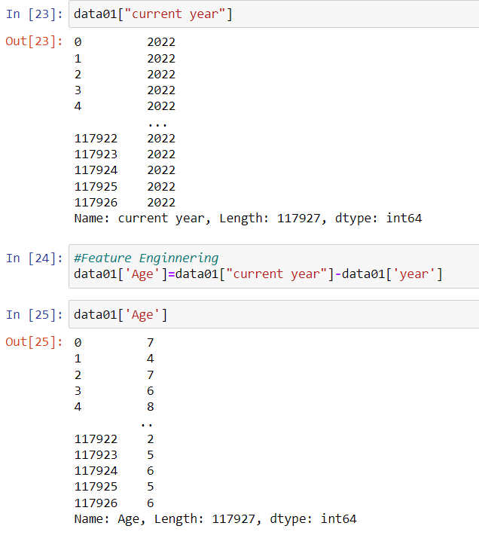
KEY FINDING STEP FOR AGE CALCULATION:
5. FROM CURRENT YEAR WE HAVE TO FIND OUT THE AGE OF THE CAR. FOR THAT REASON, WE WILL USE ‘DATETIME’ LIBRARY FOR CALCULATING THE AGE.

Slide 9
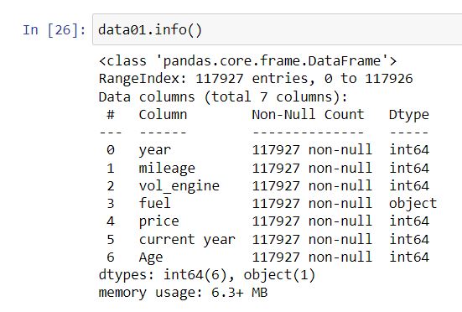
6. CHECKING FOR THE DATATYPES AND FOUND TO BE OK AS PER REQUIRMENT WITH NO NULL VALUES.

Slide 10
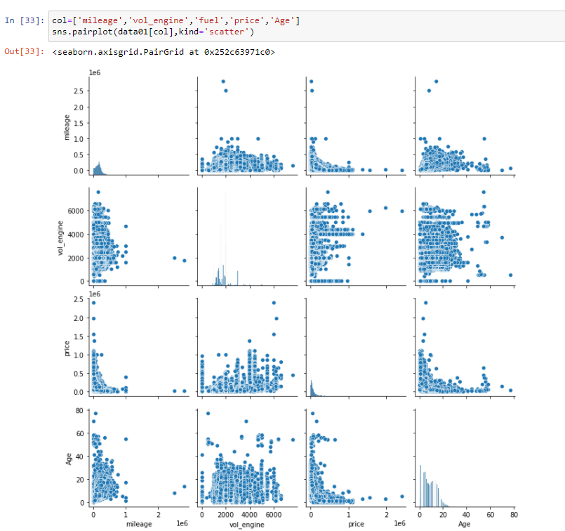
7. DATA VISUALISATION USING PAIRPLOT FOR THE COLUMNS IN DATA USING SEABORN LIBRARY.

Slide 11
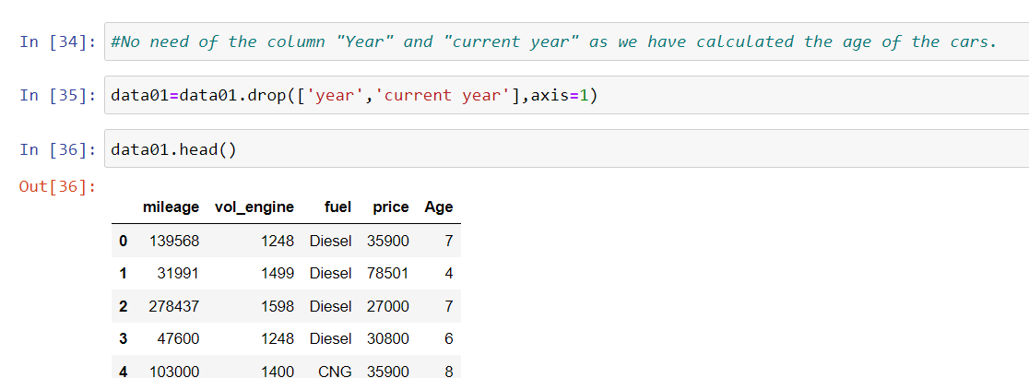
8. DROPPING THE UNNECESSARY COLUMNS AS NO NEED OF THESE COLUMNS AFTER CALCULATING THE AGE.

Slide 12
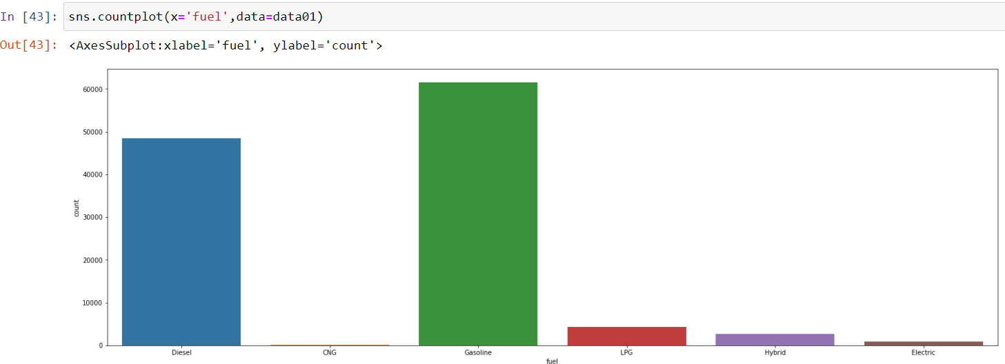
9. COUNTPLOT FOR ONLY CATEGORICAL KIND OF COLUMN ‘FUEL’.
IT REVEALS THAT MOSTLY CARS ARE OPERATED BY GASOLINE AND DIESEL TYPE.

Slide 13
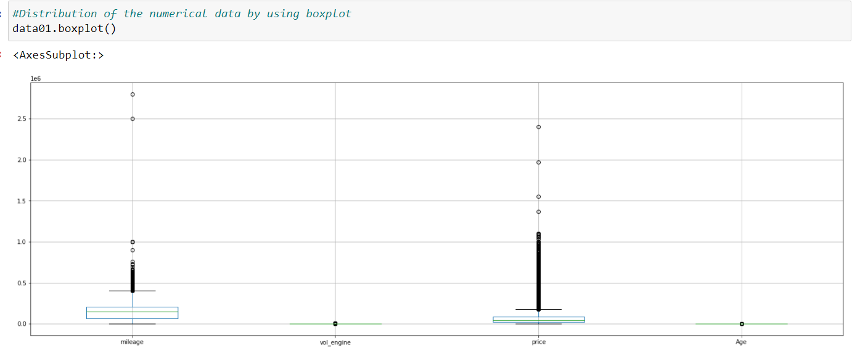
KEY FINDING STEP FOR REMOVING OUTLIERS:
10. CHECKING OF THE OUTLIERS IN THE DATA IF ANY.

Slide 14
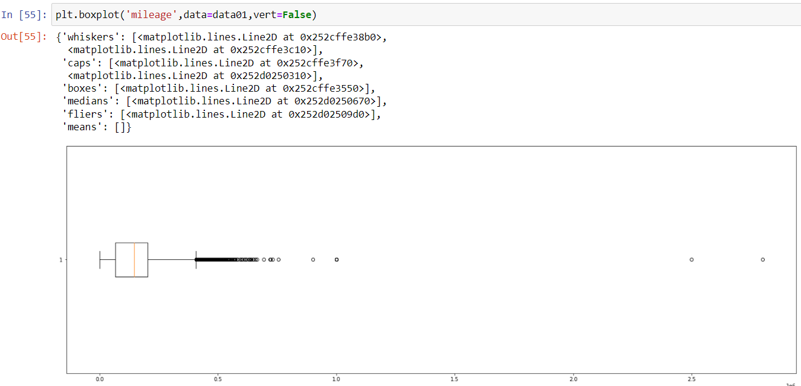
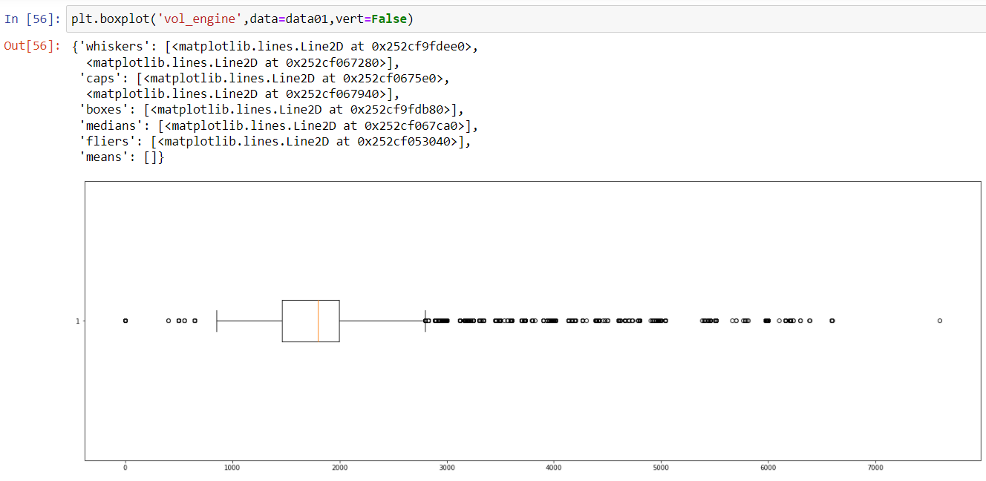
11. FOR BETTER VISUALIZATION WE WILL SEPARATELY PLOT THE BOXPLOT FOR EACH COLUMN.

Slide 15
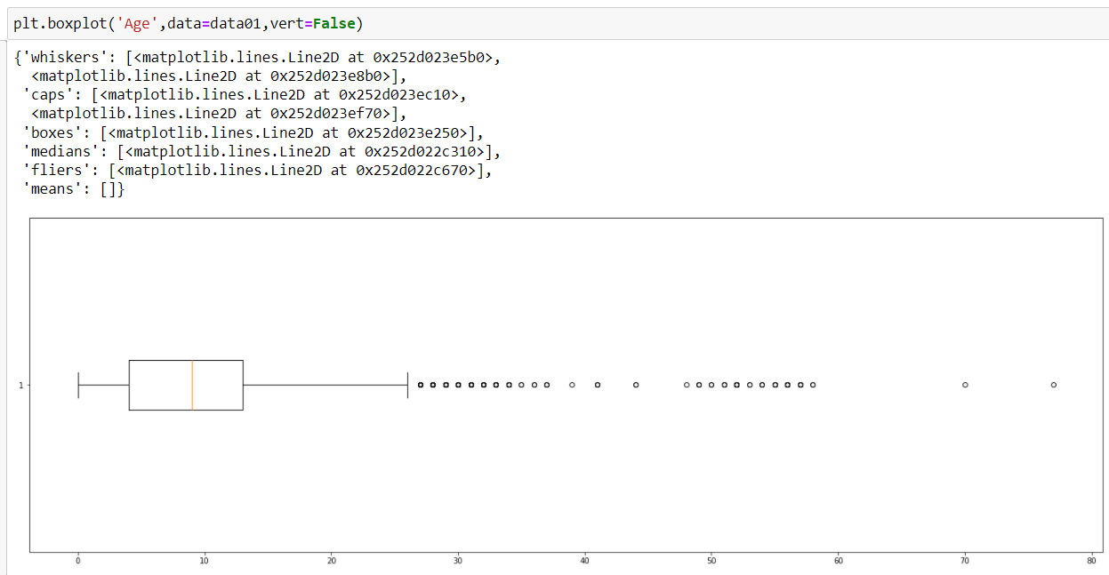
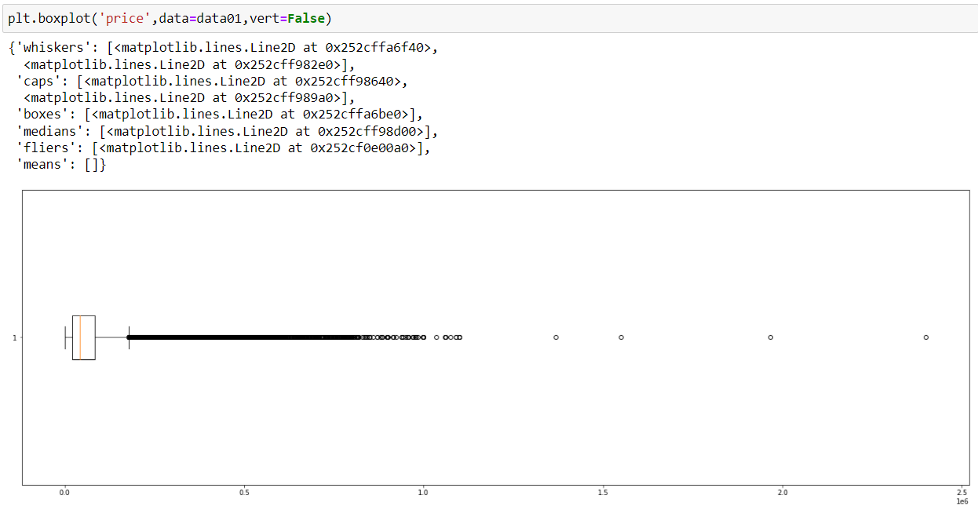

Slide 16
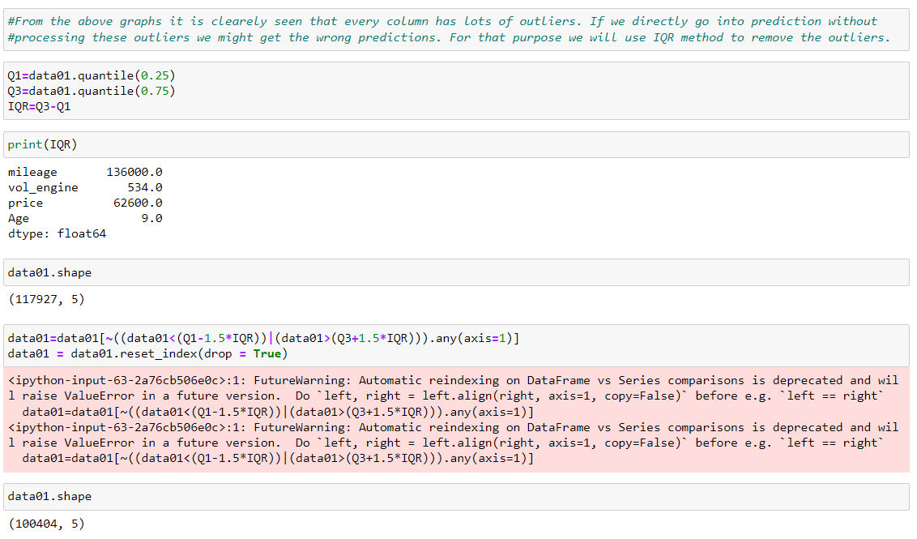
12. TREATMENT OF THE OUTLIERS BY IQR METHOD.
VERY IMPORTANT STEP IN ALGORITHM AS OUTLIERS MAY AFFECT THE PREDICTIONS VERY BADLY.

Slide 17
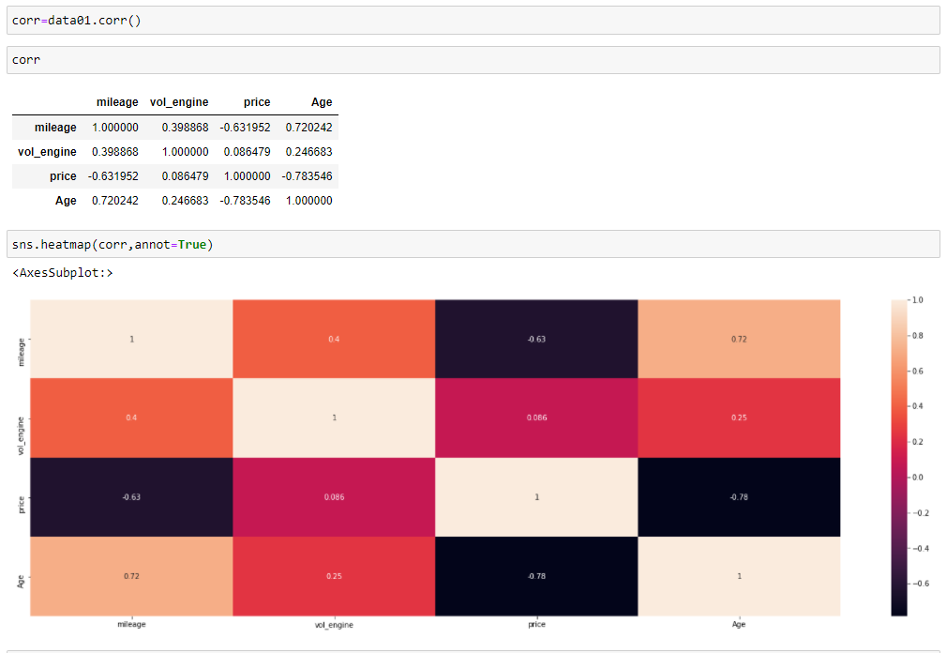
DATA IS NOT HIGHLY CORRELEATED WITH EACH OTHER. AND WE HAVE ALSO LESS NO. OF INDEPENDENT VARIABLES. SO NO NEED TO DELETE THE COLUMNS.
13. CHECKING FOR THE DATA CO-RELATION.

Slide 18
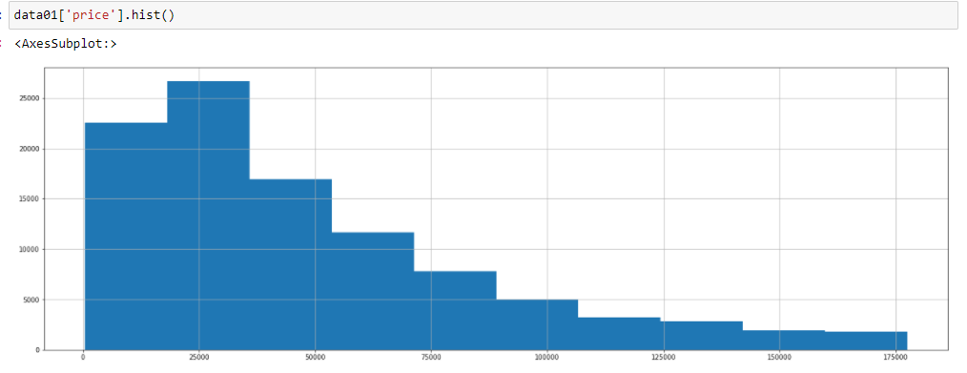
TARGET VARIABLE IS SKEWED IN NATURE. i.e. NOT NORMALLY DISTRIBUTED.
14. CHECKING FOR NORMALITY OF TARGET VARIABLE.

Slide 19
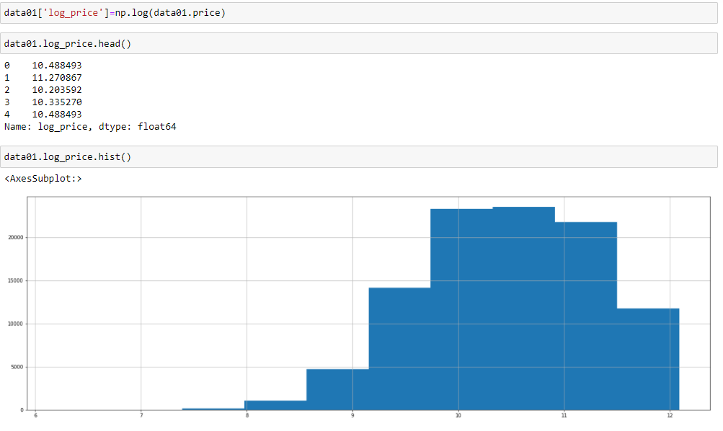
15. TARGET VARIBLE CONVERION INTO LOGARITHMIC FORM FOR MAKING NORMALLY DISTRIBUTED DATA HENCE THEREBY GOOD FEASIABILITY OF USING THE LIBRARIES .
DATA IS SOMEWHAT NORMALLY DISTRIBUTED THAN PREVIOUS ONE.

Slide 20
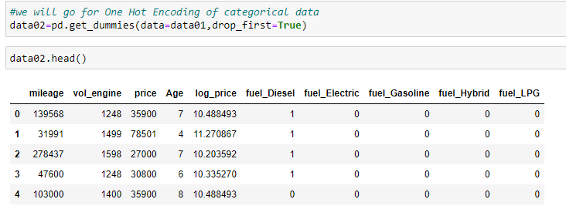
16. ONE HOT ENCODING FOR CATEGORICAL KIND OF DATA.

Slide 21
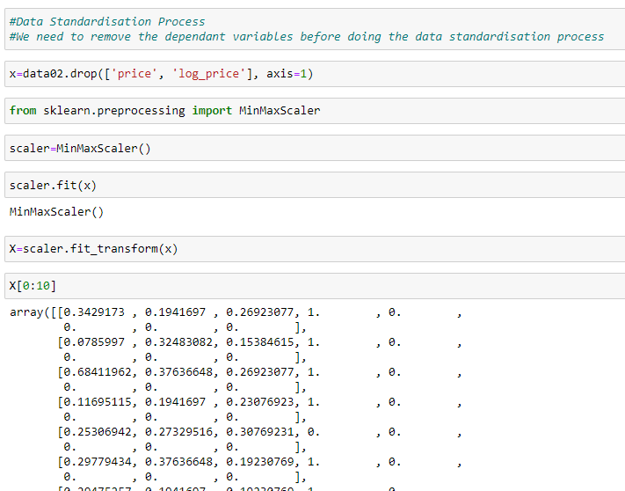
17. DATA SCALING-UP FOR BETTER WEIGHTEGE CALCULATION.

Slide 22
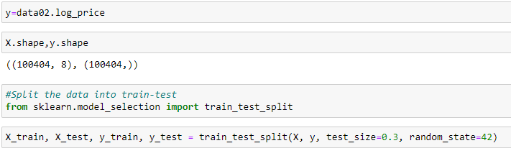
SPECIFICATION OF RANDOM STATE IS IMPORTANT TO GET THE SAME DATA AS FOR TRAINING WHEN WE RUN THE ALGORITHM.
18. SPLITTING THE DATA INTO TRAIN TEST SPLIT WITH 70:30 RATIO.

Slide 23
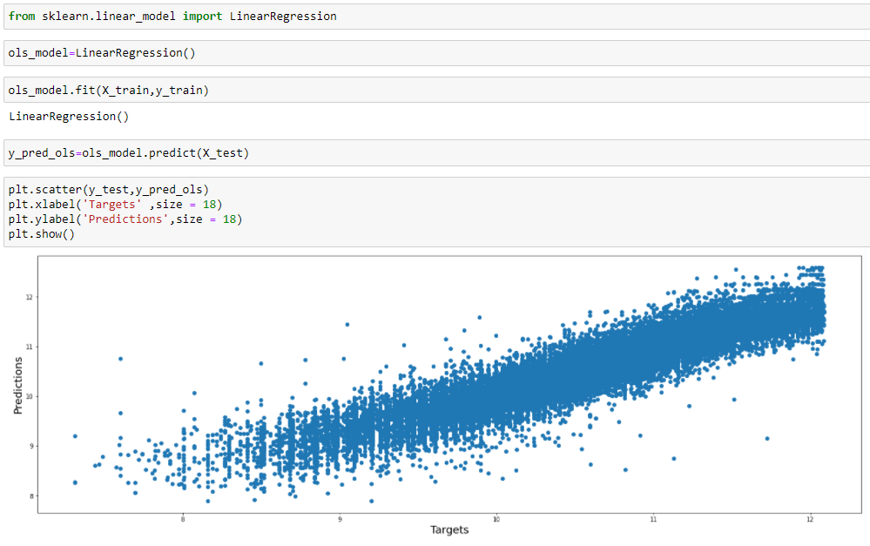
19. MODEL PREDICTION USING CLOSED FORM SOLUTION.

Slide 24
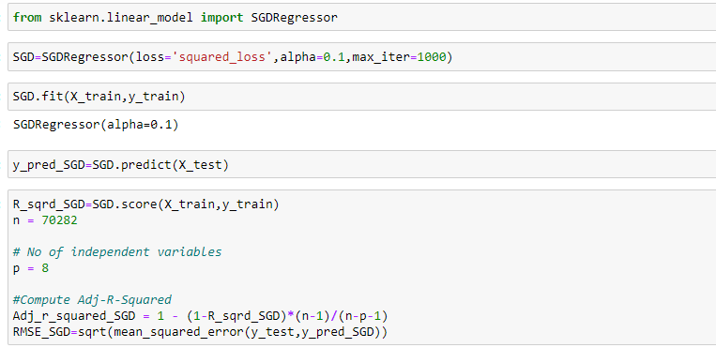
20. MODEL PREDICTION USING LINEAR REGRESSION WITH SGD.

Slide 25
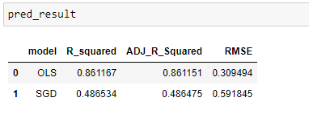
OLS GIVES MUCH MORE ACCURACY THAN SGD FOR THIS ALGORITHM.
20. RESULT COMPARISON OF BOTH THE MODELS.

Slide 26
HELP FOR BUSSINESS:
THE DATASET WAS INITIALLY CONSISTING OF LOTS OF OUTLIERS BUT WE SUCCEED TO REMOVE IT AND WE DID AN ALGORITHM WHICH WILL HELPFUL FOR UPCOMING DATA SET.
BY MEANS OF VARIOS DATA VARIABLES SUCH AS YEAR OF MANUFACTURING, MILEAGE, VOLUME OF ENGINE, FUEL OF CAR ONE CAN PREDICT THE CAR PRICE TO A GRAETER ACCURANCY WITH MINIMUM ERROS BY USING CLOSED FORM SOLUTION i.e. OLS METHOD.

